Slide 1

The Battle of the Neighborhoods

Slide 2
Business Problem
What are the most popular restaurant types/cuisines in New York City?
Which neighborhoods have the least competition for these restaurant types/cuisines?

Slide 3
Data
New York City neighborhood data:
Neighborhood name
Latitude
Longitude
Foursquare API venue explore queries:
Venue name
Venue latitude
Venue longitude
Venue category

Slide 4
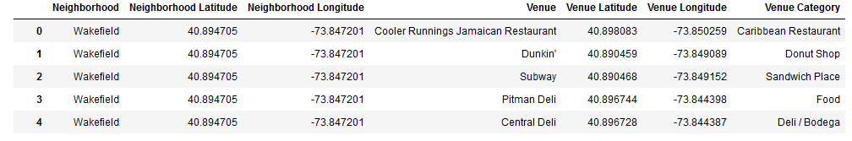
Methodology – Data Compilation
Acquire neighborhood data
Query Foursquare data, filtered by ‘Food’ parent category
Compile data

Slide 5
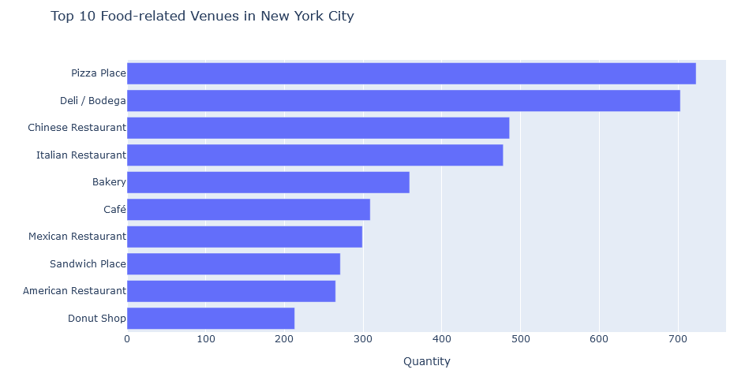
Methodology – Initial Data Analysis
8,139 venues found
143 venue categories
293 neighborhoods
Most popular venue categories by quantity

Slide 6
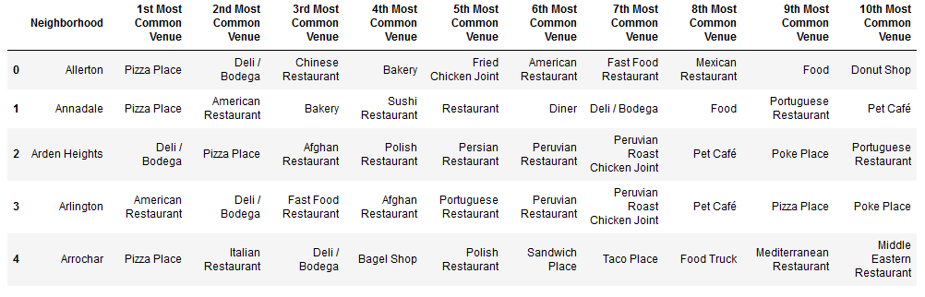
Methodology – Sorting by Neighborhood
One hot encoding
Group by neighborhood and calculate distribution frequency
Sort by distribution frequency and assign venue category

Slide 7
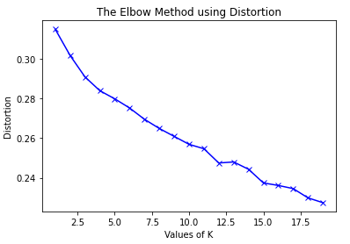
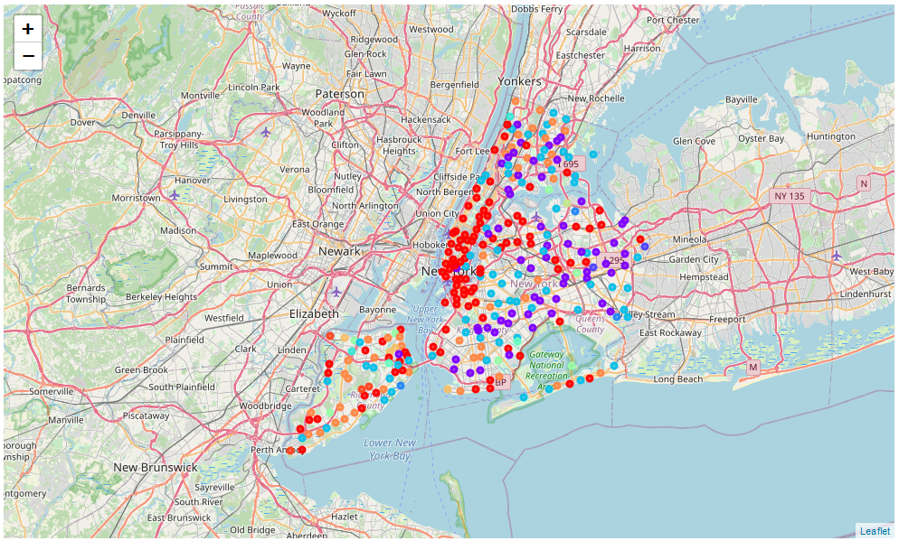
Methodology – K-Means Clustering
Apply Elbow Method
K=12 determined to be optimal value
Neighborhoods mapped by cluster.

Slide 8
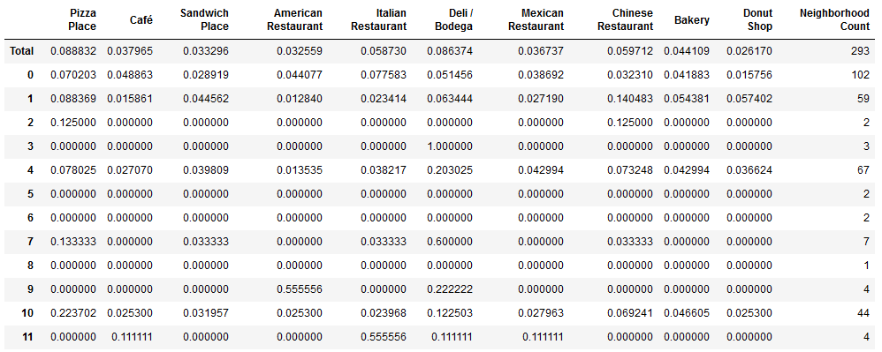
Methodology – Cluster Analysis
Neighborhood count per cluster; uneven partitioning
Distribution frequencies calculated for each cluster on most popular restaurant types/cuisines.

Slide 9
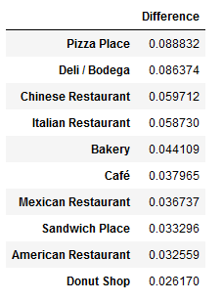
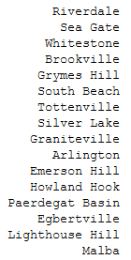
Methodology – Venue Category Selection
Maximum difference between city-wide distribution frequency and cluster distribution frequencies.
There are one or more clusters where there are no competing venues for each top ten venue category.
Pizza Place is most popular and there are 16 neighborhoods with no competition!

Slide 10
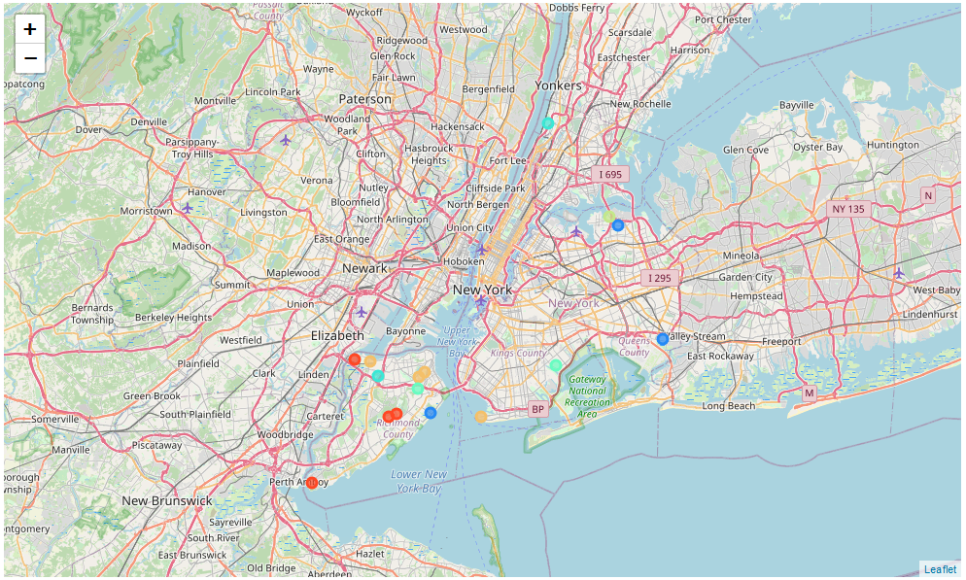
Results – Optimal Neighborhoods for New Pizza Place

Slide 11
Conclusion
Recommended restaurant type/cuisine: Pizza Restaurant
16 neighborhoods found where there is currently no competition from other pizza restaurants.
If a pizza restaurant proves to be infeasible, there are neighborhoods with no competition for each of the other nine most popular restaurant types/cuisines in New York City.

